Slide 1
Design and Analysis of Experiments Study the effect of Performance Factors on the Price of Laptop Presented by Jitendra Patel

Slide 2
INTRODUCTION
OUR INTENTION:
This Design and Analysis of Experiments specifically investigates the factors affecting purchase intention of consumers while purchasing laptops. The study is based on a primary data collected from various consumers through survey.
WHY WE CHOOSE SUCH AN EXPERIMENT:
While we land here in Fall for our first semester. All the students were looking to buy new laptops which they will be using for various purposes for next two years. All of us were looking for the best combination of specifications we can get at the best price. Which brand to take?? RAM or processor?? Graphics or Memory?? etc. This is the first thing came to our mind while choosing a project for this Course as an experiment project.

Slide 3
STEPS FOLLOWED
Problem Identification/Statement
Data Collection
Preparing data matrix & initial analysis with rapid miner. (Data Mining Software)
Filtering the important & useful data
Choose & Define Factors
Define response variable
Experiment using Factorial Design method (with the help of minitab)
Results
Interpretation of Results & Discussions
Further Scope
Conclusion
PROBLEM STATEMENT
The selection of factor that are mainly responsible to make the decision to select the laptop. Our main focus to perform this experiment is to analyze the effect of various factors that affect the price of the laptop and eventually understand the purchase intention of customers. Our result will focus on the division of mass from the population and responsible factors or interaction within the factors that plays major part in selection of laptops.

Slide 4
Data Collection
Example questions on the survey page:-
RAM Preferred?
Memory?
Processor?
Usage?
Expected Battery life??
Operating System?
Price?
Brand Preferred?
Reliability?
We received nearly 200+ responses for our experimental survey.
Rapid miner is a data mining which we used to analyze the raw data and sorted the important data & numbers which we will use for experiment.
The 200+ responses that we received were filtered & we were left with 175 response which were answered properly and can be taken as samples for our experiments.

Slide 5
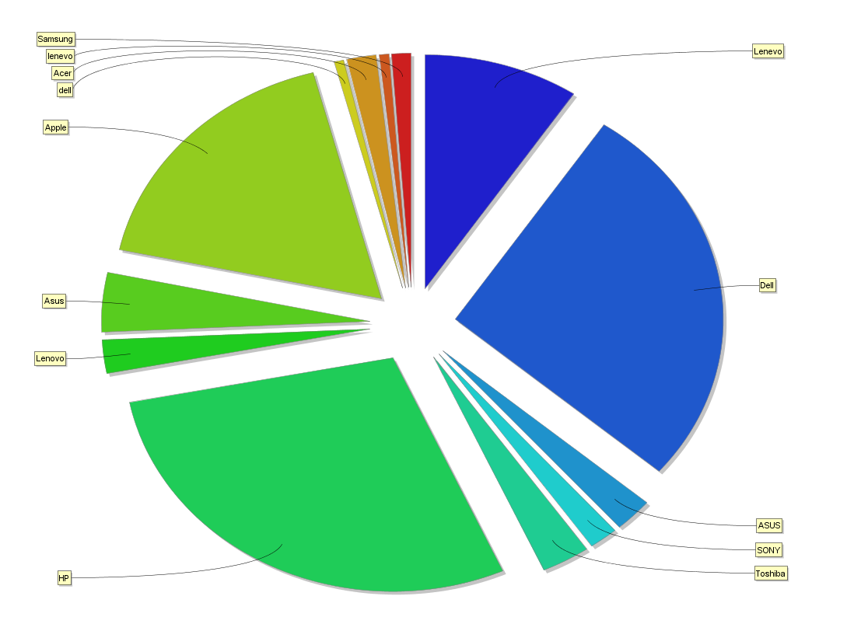
This Graph indicates the overall frequency distribution of brands. This shows the segments with green * blue colors have the highest frequencies. The actual frequencies are shown in the table below,
Dell | 46 | ASUS | 18
HP | 48 | Lenovo | 15
Apple | 30 | Others | 18

Slide 6
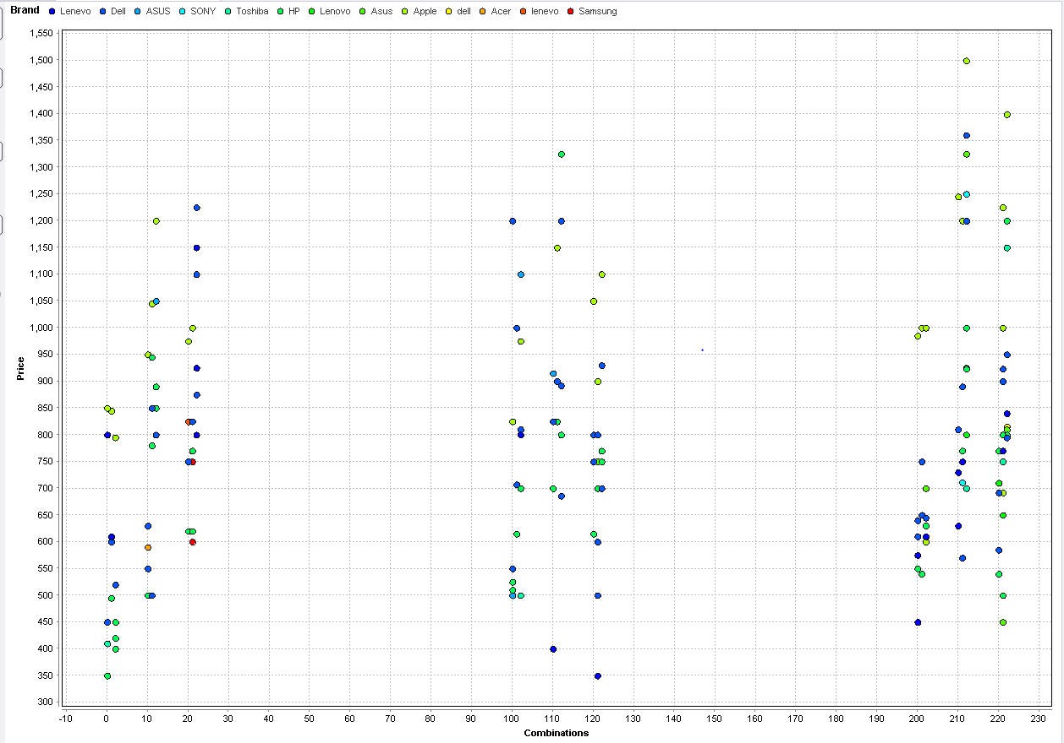
Price vs combinations over Brands

Slide 7


Slide 8
Choice of Factors and Levels:
Three factors have been selected, and each of these factors has three levels.
Factors | Levels 0 1 2
A. Specification | RAM Memory Processor
B. Purpose/Usage | Entertainment Study Business/Professional
C. Additives | Battery life Graphics Display
Selection of response variable:
The Price of laptop in dollars is the selected response variable. Consumers usually prefer certain brand over others if they get the desired performance at a price they can afford.

Slide 9
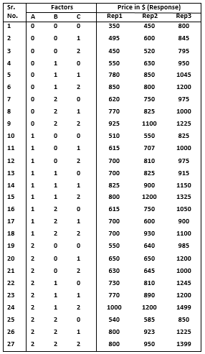
No of factors = 3
A – Specification
B – Usage
C – Additives
Response variable = Price
Blocks = 3
Factorial Design = 3³ Factorial
Total run required = 3³ x 3 = 81

Slide 10
HYPOTHESIS TESTING
ANOVA will allow us to simultaneously test the following hypotheses:
H01: µMemory = µProcessor = µRAM
Ha1: µMemory ≠ µProcessor ≠ µRAM
H02: µBusiness = µStudy = µEntertainment
Ha2: µBusiness ≠ µStudy ≠ µEntertainment
H03: µDisplay = µBatteryLife = µGraphics
Ha3: µDisplay ≠ µBatteryLife ≠ µGraphic
H04: Specification has no influence on how Usage affects Laptop Price
Ha4: There is an interaction between Specification and Usage
H05: Specification has no influence on how Additives affects Laptop Price
Ha5: There is an interaction between Specification and Additives
H06: Usage has no influence on how Additives affects Laptop Price
Ha6: There is an interaction between Usage and Additives
H07: The three factors have no influence on Laptop Price
Ha7: There is a three-factor interaction between Specification, Usage and Additives

Slide 11
ANALYSIS OF THE EXPERIMENT
p-value of 0.124 given by Anderson-Darling Normality Test is more than the significance level, hence, we can conclude that it is reasonable to assume that the data is a sample from a normal distribution.
HISTOGRAM OF RESPONSE VARIABLE PRICE
NORMAL PROBABILITY PLOT

Slide 12
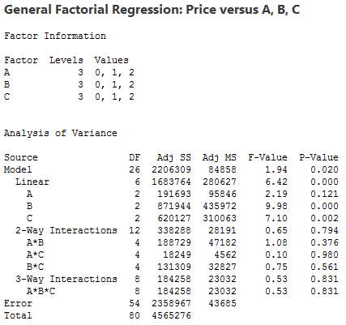
Analysis of Variance
A negative "Pred R-Squared" implies that the overall mean is a better predictor of your response than the current model.
(I) WITHOUT BLOCKING
Std. Dev. | 209.01 | R-Squared | 0.4833
Mean | 841.89 | Adj R-Squared | 0.2345
C.V. % | 24.83 | Pred. R-Squared | -0.1626
PRESS | 5.308E+006 | Adeq. Precision | 5.798
significant
significant
"Adeq Precision" measures the signal to noise ratio. A ratio greater than 4 is desirable. Your ratio of 5.798 indicates an adequate signal. This model can be used to navigate the design space.

Slide 13
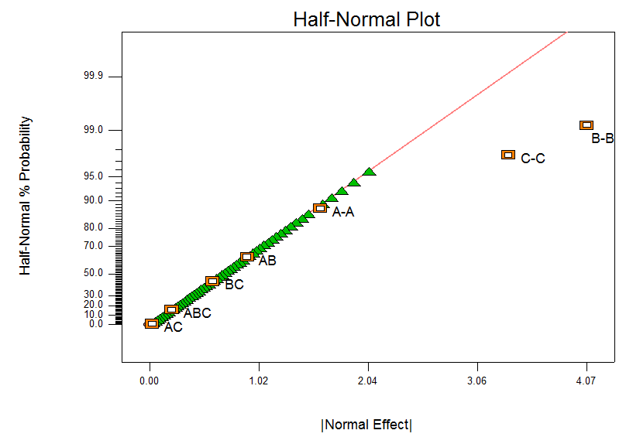
Normal Probability plot vs Residuals (without blocking)

Slide 14
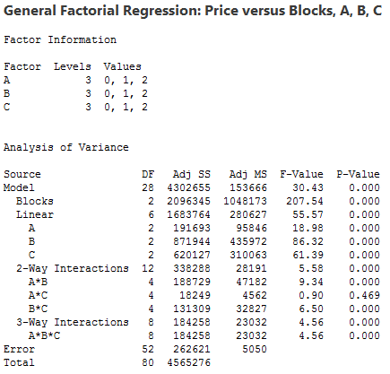
(II) CONSIDERING BLOCK ON REPLICATES
The Model F-value of 30.43 implies the model is significant.
P-Values less than 0.050 indicate model terms are significant.
In this case A, B, C, AB, BC, ABC are significant model terms.
Values greater than 0.1000 indicate the model terms are not significant.
If there are many insignificant model terms (not counting those required to support hierarchy), model reduction may improve your model.
insignificant
Blocks | Block 1 | Block 2 | Block 3
Brand | HP | Dell | Apple

Slide 15
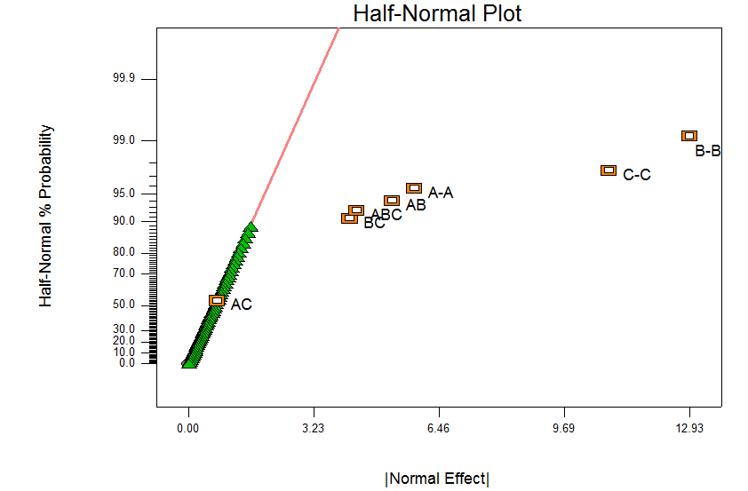
Normal Probability plot vs Residuals (with blocking)

Slide 16
Validation of Assumptions
Normality Assumptions
Residuals independence
Constant Variance

Slide 17
A. Normality Assumption of Errors (i) Normality vs Residuals
Normal Probability plot vs Residuals (without blocking)
Normal Probability plot vs Residuals (with blocking)

Slide 18
A. Normality Assumption of Errors (conti..)
(ii) Histogram Plot
Histogram (without blocking)
Histogram (with blocking)

Slide 19
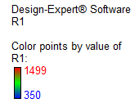
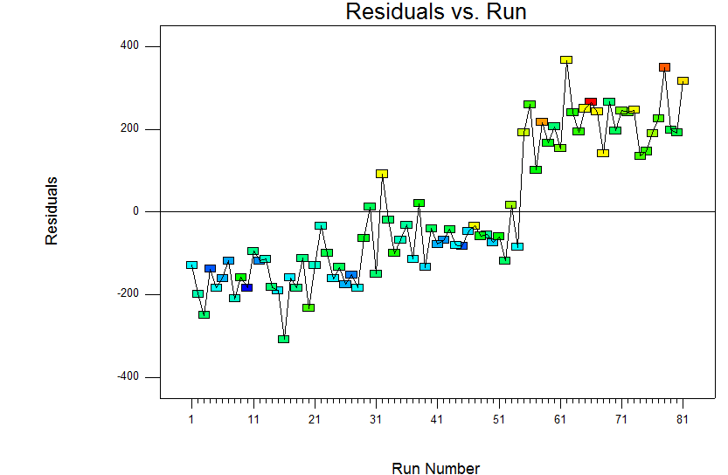
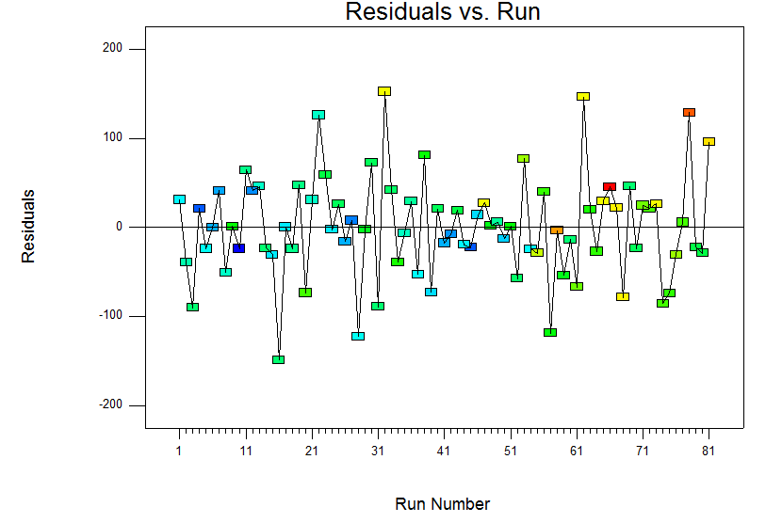
B. Assumptions for independence of errors
(Correlation Check)
Residuals vs Run (without blocking)
Residuals vs Run (with blocking)

Slide 20
B. Assumptions for constant variances
Residuals Vs Predicted (without blocking)
Residuals Vs Predicted (with blocking)

Slide 21
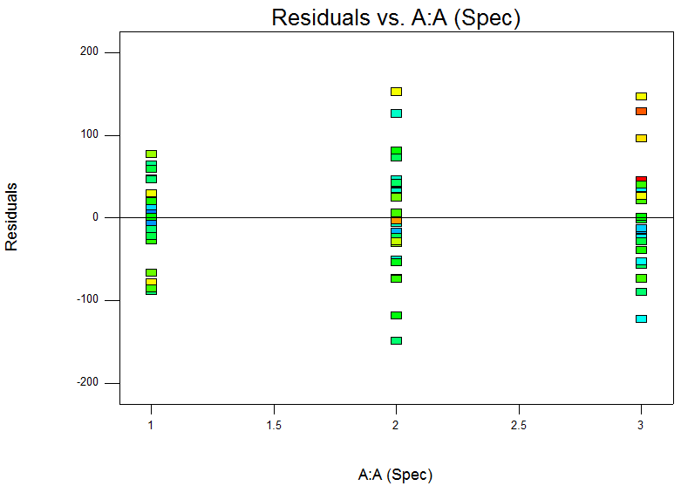
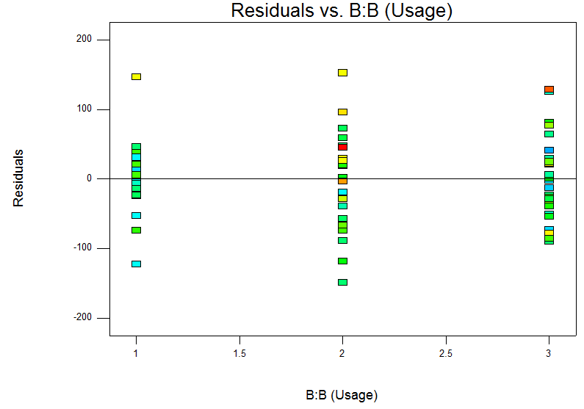
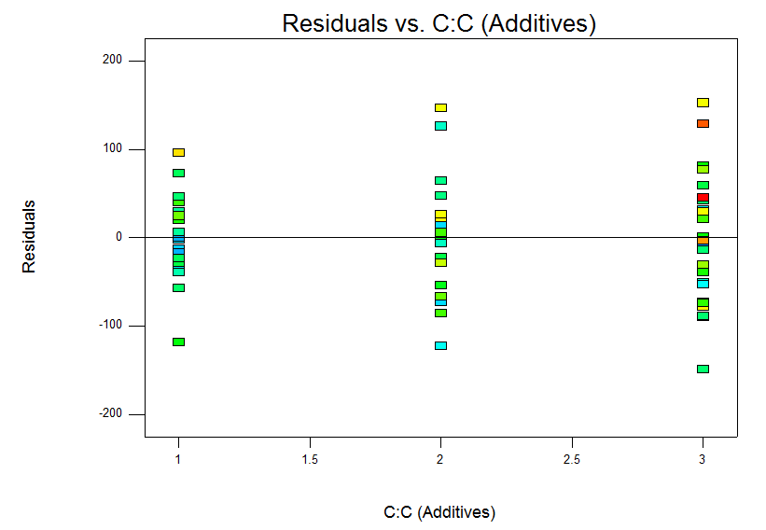
B. Assumptions for constant variances (conti..)
Residuals vs Factors Plot (with blocking)

Slide 22
Box-Cox Plot for Power Transformation
We next look at whether we can model a transformation of the response variable and obtain residuals with the assumed properties. We calculate an optimum Box-Cox transformation by finding the value of λ that maximizes the negative log likelihood.
Recommended power transformation for our model is square root transformation since after analyzing our experiment by Design Expert best value for (λ) is 0.51.

Slide 23
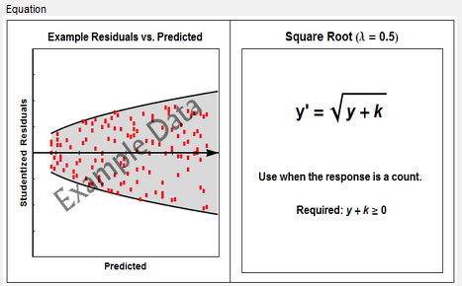


Slide 24
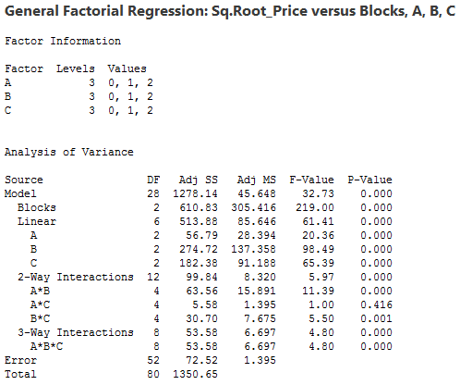
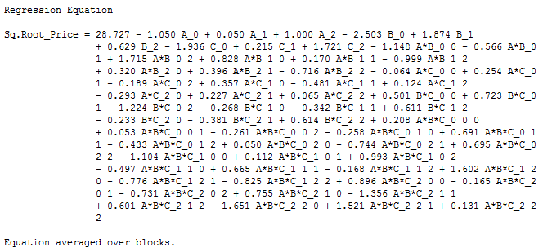
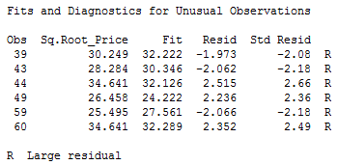
(III) POWER TRANSFORMATION
We have not removed the Unusual observations which are outliers in the model, since it might contribute towards interactions
insignificant

Slide 25
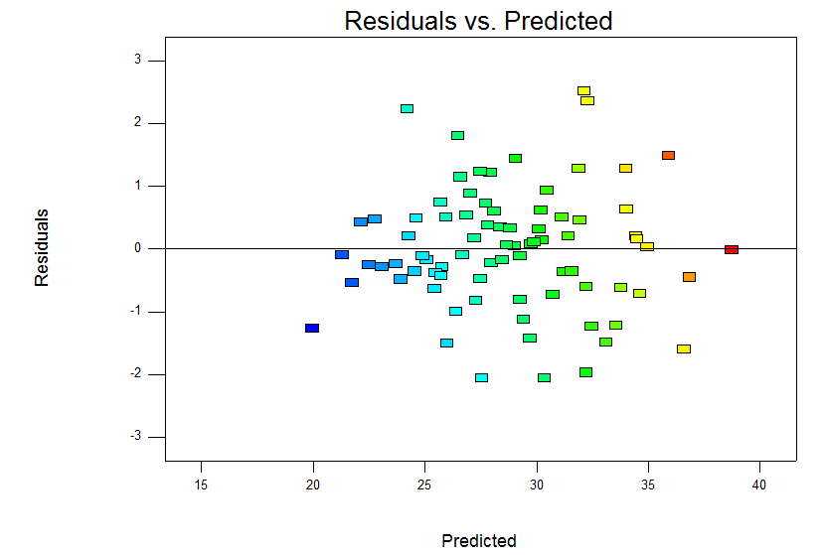
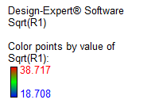
Model interpretations after Square-root Power Transformation

Slide 26
(Conti..)
R-square for ANOVA with blocking (Actual)
Std. Dev. | 71.06623 | R-Squared | 0.9425
Mean | 841.8889 | Adj R-Squared | 0.9115
C.V. % | 8.441284 | Pred R-Squared | 0.8604
R-square for ANOVA with blocking (Sq.Root transformed )
Std. Dev. | 1.1809 | R-Squared | 0.9463
Mean | 28.7265 | Adj R-Squared | 0.9174
C.V. % | 4.1109 | Pred R-Squared | 0.8697

Slide 27
COMPARISON OF ACCURACY
Prediction Vs Actual: (without blocking)
r-squared = 0.4833
Prediction Vs Actual: (with blocking)
r-squared = 0.9425

Slide 28
Prediction Vs Actual: (with blocking)
r-squared = 0.9425
Prediction Vs Actual: (with power transformation)
r-squared = 0.9463

Slide 29
Main Effects & Interaction plots
Price(Square root)
Price(Square root)

Slide 30
CONCLUSION:
The main objective of our experiment was to select the factors responsible for the selection of laptops. With respect to this we choose three factors from our survey which were most preferred by the population. Following the factorial design we came to conclusion that there is interaction between the factors.
Performing the ANOVA test on the sample data considering three replicates on the response variable i.e. price, we analyze that our main effects and interactions are significant except the interaction between specification and additives. Hence we conclude that our null hypothesis is true i.e. there is no interaction between factors - specification and additives.
Moreover, the Box-Cox Plot for the model of factorial design considering blocking suggest us that the best predictions can be achieved by power transforming our model with λ=0.51 which is the best fitting for optimum result. Also, the residual versus prediction graph indicates trend in the variance. After square root transformation on the actual model we conclude that the variance now is constant and does not show a trend. Hence, the model is fitted with square root transformation.
The square root transformed model improved the predicted vs actual plot which made our new model more suitable for predictive analysis. Moreover, the R-square value also increased respective to the actual model, which further strengthen our transformed model.
This experiment help us to analyze the price of laptop for the various combination of the major factors and eventually is responsible for the selection of desired laptop. In today’s market, where there are numerous options available for selecting a laptop, buying a laptop can be a tedious task. Also there is a probable risk of selecting a unnecessarily high priced laptop for same possible combination. This experiment gives us the optimal cost for every combination of laptop we choose, which further reduces the risk we mentioned above.
In addition, there is no longer monopoly in manufacturers of laptops, which introduces huge competition among these manufacturers. This experiment will help such companies to analyze the current preferences of factors in selecting a laptop by any prospective customer. Hence, this experiment will help the laptop manufacturing companies to introduce a desirable sales force to increase their business sales considering these factors.

Slide 31
Further Scope of Analysis
The customer who are acquired from competitors can be either satisfied switcher or dissatisfied switchers. Hence, it is equally crucial to learn about whether there is difference among stayers, satisfied switchers and dissatisfied switchers with respect to their laptop purchase decision factors. This issue becomes exceptionally vital when the consumers decide to upgrade/change their laptops.
With advancement in the technology there is possibility of change in the factors dominating the selection of laptops.
We have presently considered price as our main responsible variable for selection of laptop. This implies that selection of laptop is solely decided by the price which cannot always be the case. We can think of introducing other response variables such as number of customers within the population intend to take a particular combination of factors.
Moreover, the interaction of these factors would affect the sales of a particular brand of laptop.

Slide 32


THANK YOU !
Questions

